Slide 1
Cover Letters and Resumes
Applying for Work

Slide 2
Cover Letters - Format
Use fully-blocked letter style (all lines start on the left margin)
Use Post Office preferred addressing:
    Charles Campbell College
    3 Campbell Road
    PARADISE SA 5075
Add an inside address (address of the business you are writing to)
Punctuation only in the sentences in the body of the letter.
See sheet Cover Letters for suggestions about what to write in each paragraph.
Use the appropriate close
Leave room for your signature

Slide 3
5 jobs to choose from
1
Needed a casual assistant to work at Hoyts Cinema TTP. Duties include working in the ticketing/refreshment area. Collecting tickets and ushering late patrons to their seats. Some late night shifts required. Must be flexible and possess sound communication skills. Experience handling money desirable.
The Messenger newspaper. 26 November 2016.
2
Needed a casual assistant to work at a McDonalds at Holden Hill. Duties include food preparation, register. Some late night shifts required. Must be flexible and possess sound communication skills. Ability to work in a team and experience handling money desirable.

Slide 4
5 jobs to choose from cont’d
3
Needed a casual assistant to work at Drake supermarket Newton Gardens. Duties include working on the registers and stock taking. Training will be provided for those who wish to work in specialised areas eg Deli. Some late night shifts required. Must be flexible and possess sound communication skills. Experience handling money desirable.
4
Needed a casual person to work at a Paradise Motors on Saturdays. Duties include washing cars and cleaning the workshop. Must be prepared to wear appropriate safety clothing. Must be flexible and possess sound communication skills and work to a deadline.

Slide 5
5 jobs to choose from cont’d
5
Needed a casual person to work at a Café Va Bene Gorge Road Paradise. Duties include making coffee. (Training will be provided.) Must be prepared for early starts and work on weekends. Must be flexible and possess sound communication skills. Experience handing money desirable. Must be prepared to work as part of a team.

Slide 6
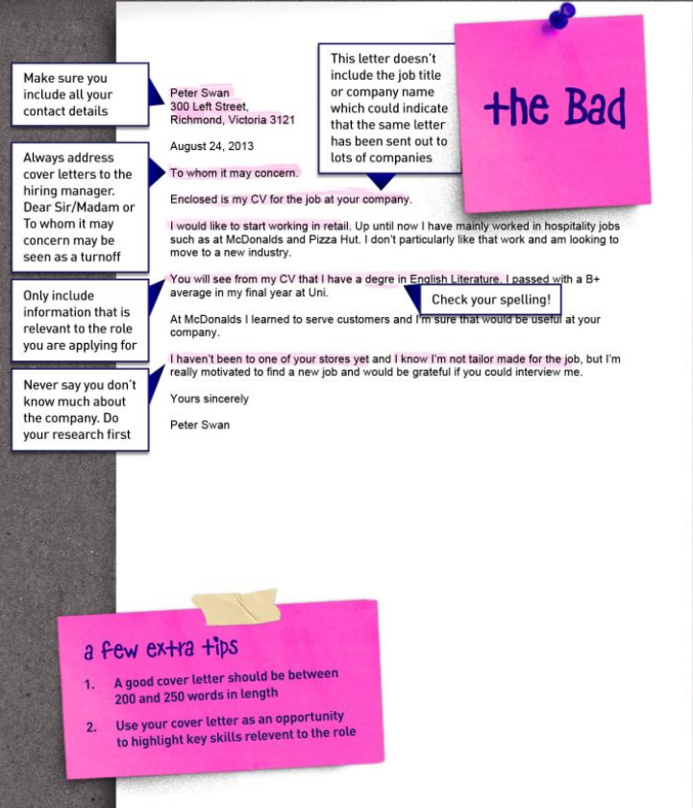
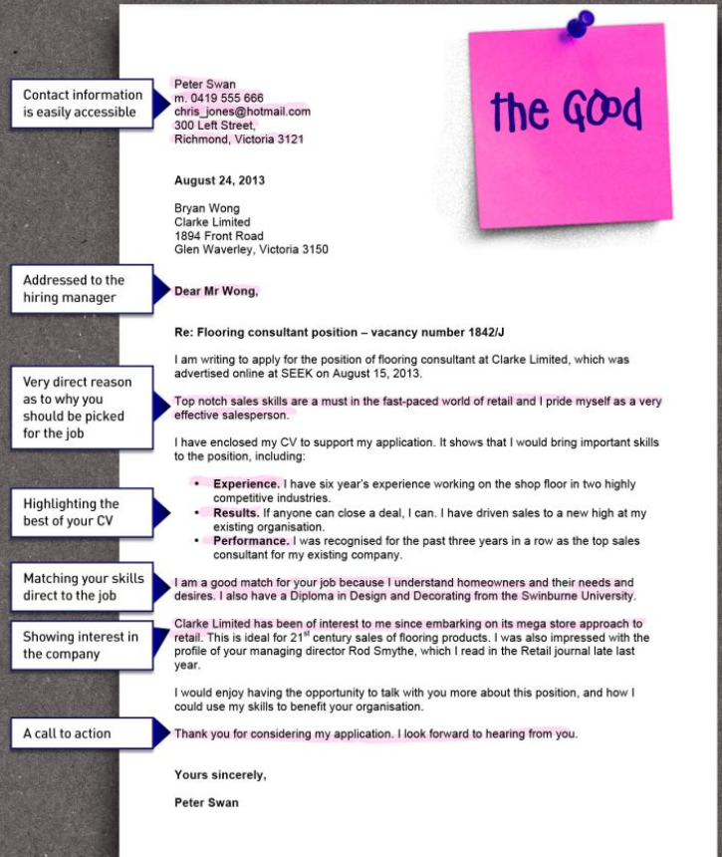

Slide 7
Resumes
Read the sheet writing a resume. Take note of points 2 – 6.
You can use the supplied resume template to complete your resume.
There is an annotated example to remind you about what to add to each section.
Remember to make your resume look good by following an interesting format that will make yours stand out. See examples on this PowerPoint presentation.

Slide 8
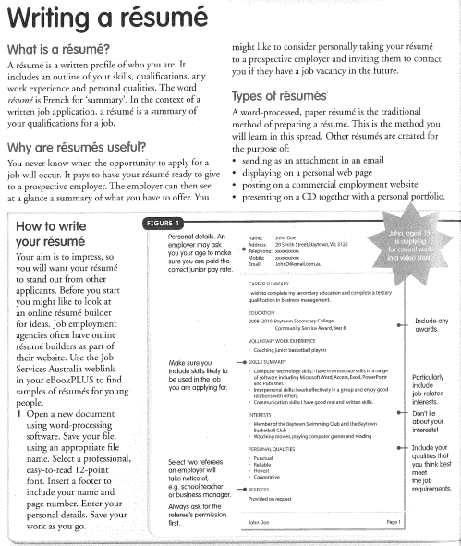
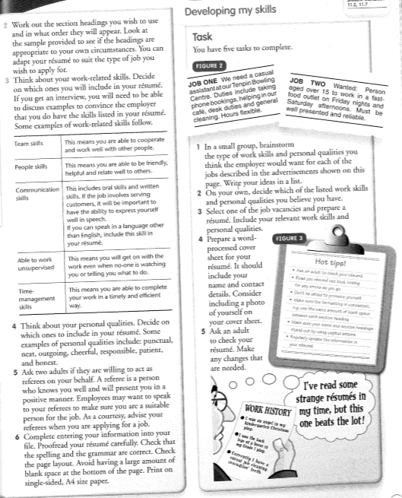

Slide 9
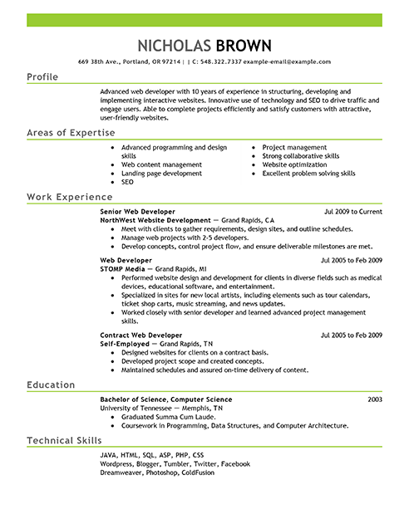
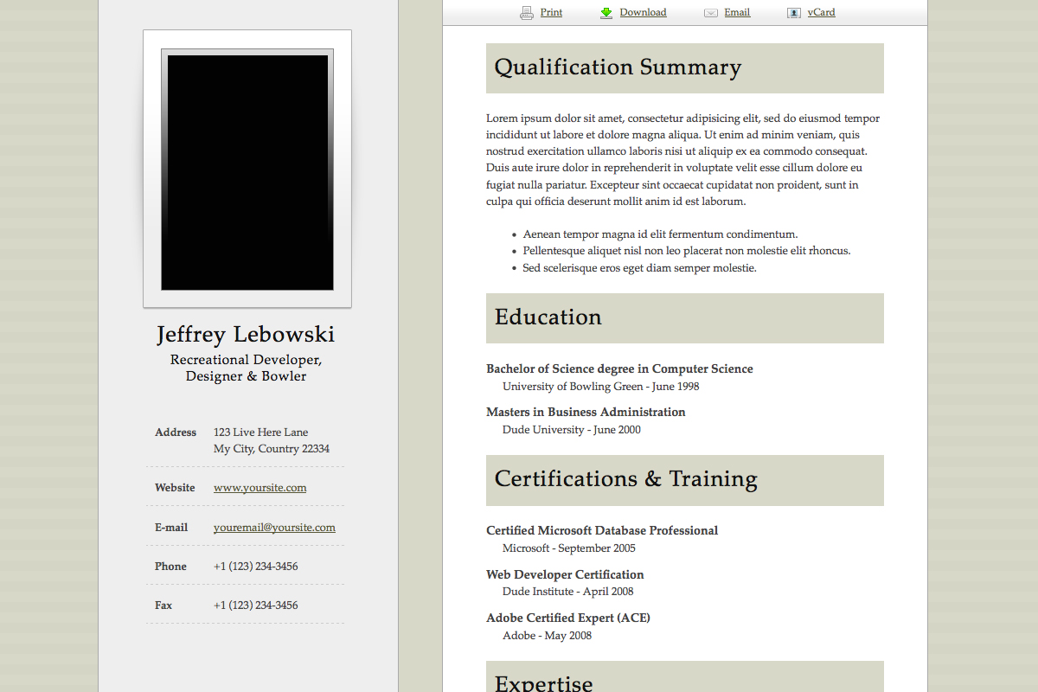
Examples of formats for Resumes

