Slide 1
Question Design for Investigations
Activities and strategies to help students

Slide 2
Question design
Getting started:
It can be difficult to get started on an investigation.
It might be useful to think of a topic which interests you before devising a question.
A broad topic can be narrowed down to become a question.
Consider the subject requirements for the investigation.

Slide 3
Topic Choice
When you start to search for a topic it can be useful to think about:
School: subjects and extra-curricular activities
Outside school: hobbies, sports, part-time job, interests, volunteering
Personal experiences
Contemporary issues
Environmental concerns
Creative arts (music, film, other forms of entertainment).

Slide 4
Mind mapping your topic
It can be helpful to visualise your topic using a mind map.
Jotting down your interests in this way can help you to begin to see topic ideas.
It may also help you to make links between your interests and this can help you formulate a question.
Look at the example on the next slide and then write down your own ideas in the form of a mind map.

Slide 5
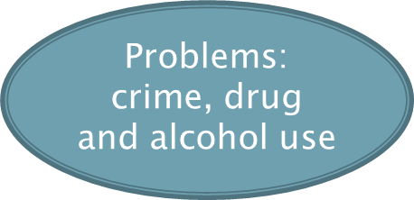
Mind mapping
social issues
science
in my community
experiments
lack of services
What are my interests?
soil pH and moisture content
unemployment
types of plants
gardens

Slide 6
From topic to question
Once you have settled on an area that interests you it is a good idea to do some initial research.
Doing some reading and internet research will give you an idea of how much information is already available.
Sometimes this initial reading and research may lead you to ask questions which could form the basis for your investigation.

Slide 7
From topic to question
The diagram below can also help you to narrow your topic and make it easier to design a question.
General
Narrower
Narrower
Specific
Environment
Coastal erosion
Beach protection
Breakwaters,
Groynes
Try this exercise with your topic.

Slide 8
From topic to question
You can refine your question by applying the following:
Can it have a local perspective?
This may make it easier to gather data
Can it be set within a specific historical time frame?
This will prevent your question from being too broad
Can it be based on a specific section of the population?
This will provide a focus for your research
These refining questions won’t apply to all subjects but they may help you to narrow your question in some.

Slide 9
From topic to question
A useful acronym to use when designing your question is FINER (Hulley et al. 2013).
Ask yourself if your question is:
Feasible?
Can it be researched? Can it be managed in the time you have available?
Interesting?
Will it challenge you and give you the chance to learn something new?
Novel?
Will it result in original and key findings?
Ethical?
Is it safe and ethical to research?
Relevant?
Is it relevant and does it meet the learning requirements of the subject?

Slide 10
Quiz: Can the topic be researched?
1. Do aliens come from Mars?
No. In the first instance there is no concrete evidence that aliens actually exist and so this is not a feasible topic. Although there is lots of written material about aliens and also about the planet Mars it would be difficult to support a credible viewpoint. This is also unlikely to be relevant to the subject.

Slide 11
Quiz: Can the topic be researched?
2. Is there a link between video games and violence in children?
Yes. This is feasible because there is published material about the impact of video games on child behaviour. It might be easier to refine the question to a specific age group of children. This will be interesting and novel, particularly if it focuses on a specific game.

Slide 12
Quiz: Can the topic be researched?
3. How effective are tornado warnings?
Yes. Again this topic is feasible because there is a lot of published information about the systems used for tornado warning. It might be appropriate to narrow this down to a specific geographical area, this would reduce the information to be sorted through and is more likely to produce novel findings.

Slide 13
Quiz: Can the topic be researched?
4. Which soft drink is better? (Insert brand names).
No. The word “better” has no real meaning and so there is nothing to measure and the topic is not feasible. If the wording were refined to include reference to nutritional or calorific value it could become researchable and also more relevant.

Slide 14
Quiz: Can the topic be researched?
5. Is there a link between soil pH and plant types found in sand dunes?
Yes. There is lots of information available and so the topic is feasible. This question allows you to carry out your own first hand data collection which will be both interesting and will result in original findings. This could be narrowed down to a specific geographical location.

Slide 15
Question wording and stems
The wording of your question is very important as it provides a focus for your investigation.
It should define the types of data you need to collect and the methods to do so.
It is important to remember that the wording and focus of your question can change as you gather information.

Slide 16
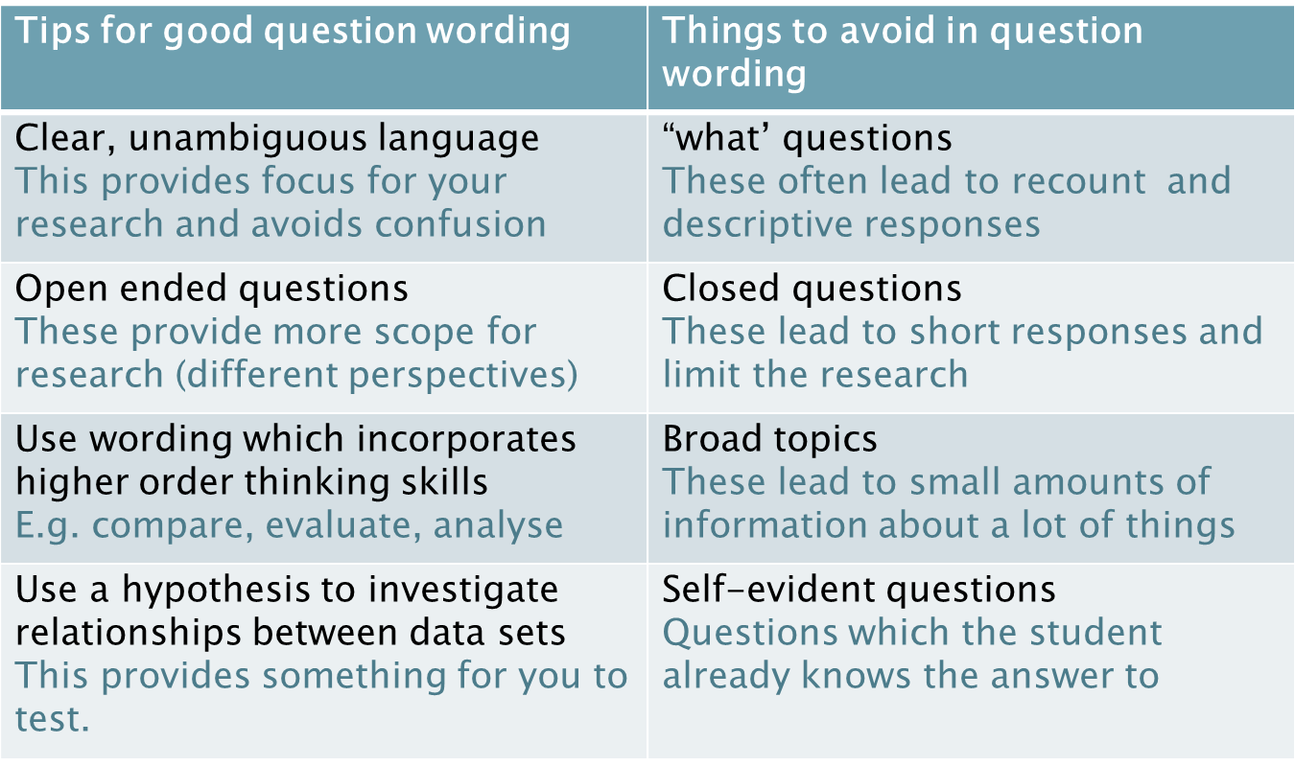
Question wording and stems

Slide 17
Useful question stems
What is the relationship between………..?
How useful ………..?
To what extent………..?
How effective are………..?
A comparison of………..?
What is the impact of ………..?
How important………..?
How accurately does ………..?
How does ……….. influence ………..?

Slide 18
Quiz: Question wording
The following slides give two versions of a question for investigation.
Decide which is the best question.
Think about:
Question stems, question wording and what should be avoided.
Answers are provided.

Slide 19
Quiz: Question wording
Question 1:
A. What types of plants grow on a sand dune?
B. How does soil salinity impact on sand dune succession?
A This is a “what” question and leads to a descriptive response.
B This allows for investigation of the relationship between salinity and the types of plants grown along a sand dune.

Slide 20
Quiz: Question wording
Question 2:
A. How effective was short-term aid following the Haiti earthquake in 2010?
B. How important is short-term aid?
A. This question allows the student to investigate different perspectives and it is focused on one event.
B. This question is too broad and not linked to any natural disaster.

Slide 21
Quiz: Question wording
Question 3:
A. Do male students perform better at school than females?
B. To what extent do males outperform females in technical subject examinations?
A. This question is quite vague and lacks a focus for research. There is no indication of the criteria for measuring performance.
B. This allows students to investigate different perspectives but has a focus on exam results and a specific suite of subjects.

Slide 22
Quiz: Question wording
Question 4:
A. How accurately does the film, The Great Gatsby, represent the clothing fashions of the 1920s?
B. How is the fashion of the 1920s represented in the film, The Great Gatsby?
A. This invites argument and has a clear purpose. The use of a time frame provides focus.
B. This question lends itself to description only.

Slide 23
Quiz: Question wording
Question 5:
A. Does the socio-economic background of parents affect the future of their children?
B. What is the relationship between the income earned by parents and the academic achievements of their children?
A. This is very broad and could be answered yes/no. The word future doesn’t provide focus.
B. This has clear purpose and the parameters are defined (income and academic achievement). Could be narrowed further by giving a location.

Slide 24
Quiz: Question wording
Question 6:
A: To what extent are people influenced by distance when shopping?
B. How far do people travel to do their weekly food shopping?
A. This allows research of different perspectives and also is suitable for first-hand data collection.
B. This topic is too narrow and lends itself to description.

Slide 25
Refining the question
It is important to allow your question to change.
Once you start to collect data you may find that you notice elements of data which you would like to investigate further.
Once your start to analyse your data you may discover patterns or interesting results which change the focus of your investigation.
Your question provides focus for data collection and analysis but these also help to shape your question.

Slide 26
Refining the question

Slide 27
Refining the question - example
Public Transport
ORIGINAL QUESTION: How effective is Adelaide’s
public transport system for daily commuters into
the city?
REFINED QUESTION: How effective are Adelaide trains for
daily commuters from the southern suburbs into the city?
Data collected: more information gathered about train services than
bus services, easier to collect data only for suburbs south of the city

Slide 28
Can you turn these topics into questions?
Think back to the questions stems and try to apply these.
What is the relationship between………..?
How useful ………..?
To what extent………..?
How effective are………..?
A comparison of………..?
What is the impact of ………..?
How important………..?
How accurately does ………..?
How does ……….. influence ………..?
AFL
Vampires
Farm animals
Air travel
Ocean
Deserts
Fashion
Acids
Flooding
Dogs
Shopping

Slide 29
References
George Mason University Writing Centre 2014, accessed 29 August 2014, ‘How to write a research question’, <http://writingcenter.gmu.edu/writing-resources
Hulley,SB 2013, ‘ Getting Started: The anatomy and physiology of clinical research’ in Designing Clinical Research, Hulley,SB, Cummings, SR, Browner, WS, Grady DG, Newman, TB, Lippincott Williams and Wilkins, Philidelphia, p10
SACE Board of SA 2013, Advice on Designing a Research Project Question. South Australia
SACE Board of SA 2013, Beginning the Thinking for the Research Project. South Australia
SACE Board of SA 2014, Designing a Question for Research or Investigations: Guidelines for Teachers. South Australia.

